Slide 1
Characters in Frankenstein
Who is
Victor Frankenstein
A classic mad scientist transgressing all boundaries without concern?

Slide 2
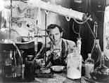
or
A brave adventurer into unknown scientific lands, not to be held responsible for the consequences of his explorations.

Slide 3
>reads the works of ancient alchemists
Attends university, studies modern science.
Within a few years masters all that his professors have taught him
Brings a hideous monster to life
Victors youngest brother, wife and best friend are killed
Torn by remorse, guilt and shame Victor refuses to admit/confess his creation has caused such damage
VICTOR FRANKENSTEIN

Slide 4
MONSTER
8 FOOT TALL
*GROTESQUE
*INTELLIGENT AND SENSITIVE
*FEELING OF ABANDONMENT COMPELS HIM TO SEEK REVENGE

Slide 5
Women in the Novel
ELIZABETH LAVENZA
JUSTINE MORITZ
Waits patient and helpless for Victor
Executed for murder despite her innocence
BOTH WOMEN REPRESENT PASSIVITY.
THEY ARE ILL TREATED AND HAVE NO VOICE

Slide 6
Compare/ Contrast
Victor and the Monster
Elizabeth and Justine
Victor is obsessed with creating a living being from body parts
(creating life)
Puts a hold on love to pursue his research.
Monster is obsessed with destroying all that Victor holds dear (rampage of murder)
Intelligent- blind family
Passive
Gentle
Patient
Victims

Slide 7
Motifs
Definition of Motif:
Examples of motifs in the text
Are recurring structures, contrasts and literary devices that can help inform and develop the text’s major themes.
Abandonment:
Justine –orphaned
Elizabeth- forgotten for a time while Victor pursued research
Monster- abandoned by his creator

Slide 8
Motifs (continued)
Abortion:
Victor speaks of his creation “I ardently wished to extinguish that life which I had so thoughtlessly made”
Monster: feels ‘lonely and dejected’
In the novel he speaks ‘I am an abortion to be spurned at…’
Passive women:
Justine, Elizabeth and the female monster are passive
They have no voice
They are all killed

Slide 9
THEMES
Themes are the fundamental and often universal ideas explored in a literary work.
Dangerous knowledge
Secrecy

Slide 10
SYMBOLISIM
Light: knowledge, discovery, and enlightenment
Fire: what do you think fire symbolises?
Read the book and Describe the monsters first experience with a still- smoldering flame

Slide 11
The monster discovers the dual nature of fire : it creates light in the darkness of the night and brings warmth, but also that it can harm
symbolism

Slide 12
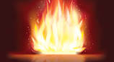
warmth, comfort, home (fire- place) / danger, death BINARY OPPOSITION

Slide 13
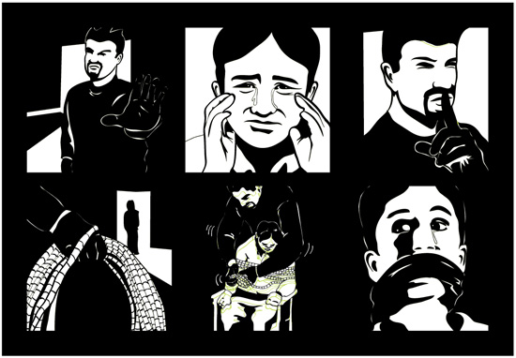
GRAPHIC NOVEL STUDY
DOES THE PICTURE HAVE MEANING WITHOUT THE TEXT?

Slide 14
What is happening?

